Slide 1
Capstone Presentation
Telecom Churn

Slide 2
Problem Identification
How can The Orange Telecom decrease customer churn by X% before the end of the next fiscal year by focussing their efforts on the factors that are most closely related to custom churn.

Slide 3
Recommendation and Key Findings
Lower Day Time Pricing
Lower Day Time Pricing
Location & Voicemail are Irrelevant

Slide 4
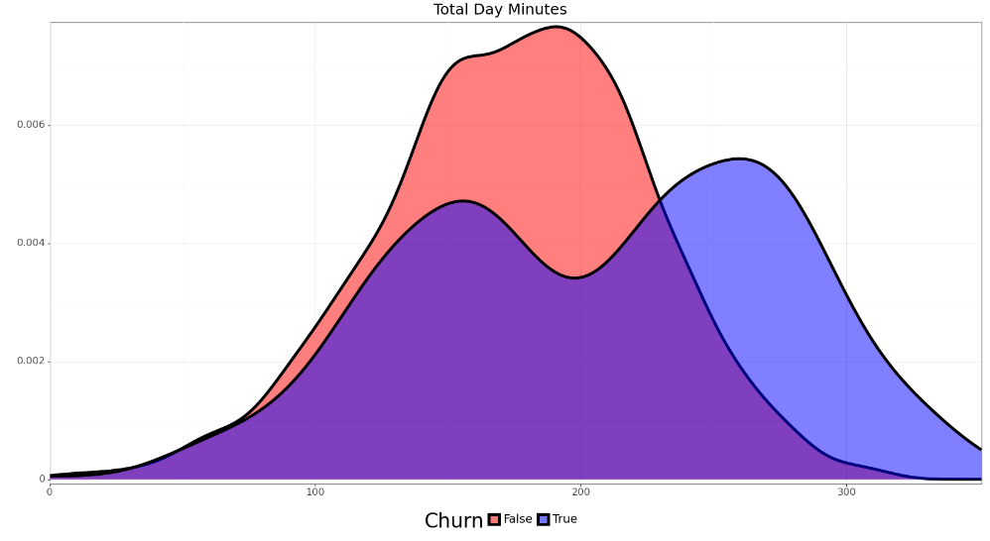
Recommendation 1: Lower Day Time Pricing
Day calls were by far the biggest factor determining Churn
~⅓ of calls take place during the day
Day pricing is twice as much as evening and about 4x as much as night pricing
Pricing
Day Price: $0.170/min
Eve Price: $0.085/min
Night Price: $0.045/min
International Price: $0.270/min

Slide 5
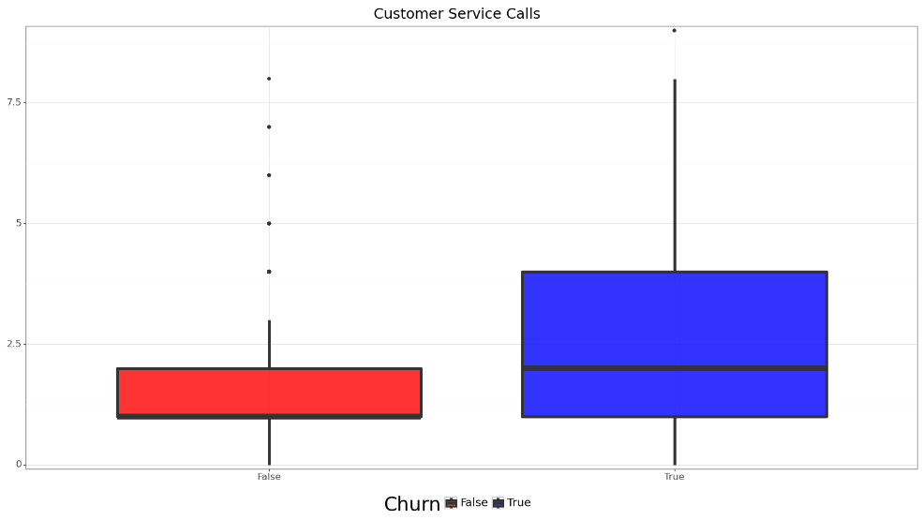
Recommendation 2: Flag Repeat Customer Service Callers
Repeat Customer Service callers are more likely to churn
Set a threshold of customer service calls and flag customers who excede
Offer a temporary discount on daytime calls

Slide 6
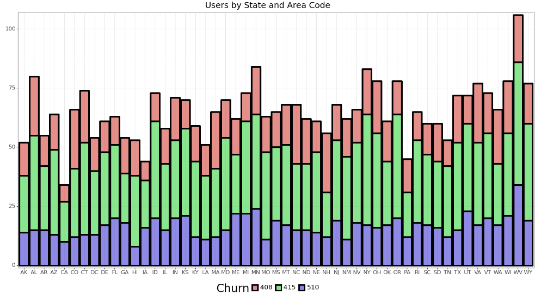
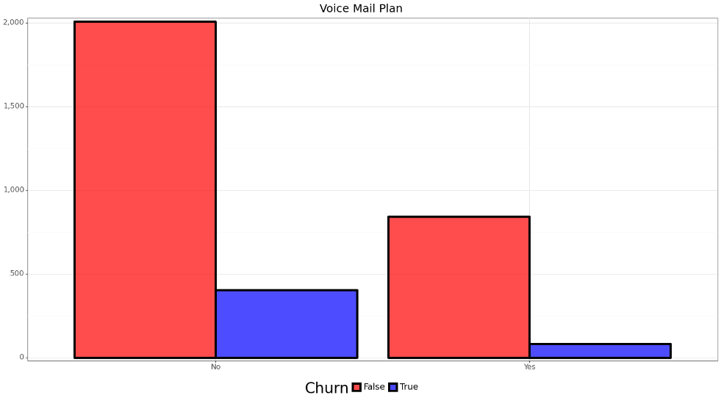
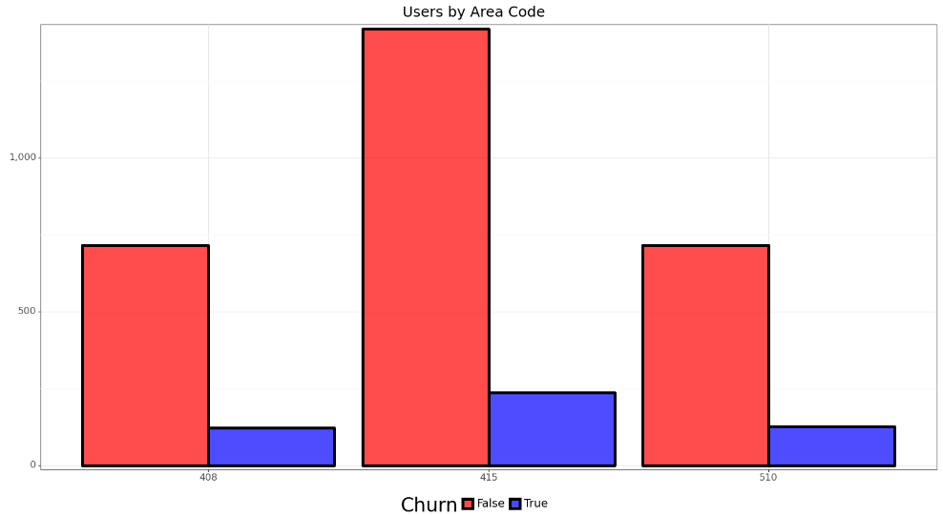
Recommendation 3: Location & Voicemail are Irrelevant
Metrics regarding location and voicemail provided nothing in determining churn

Slide 7
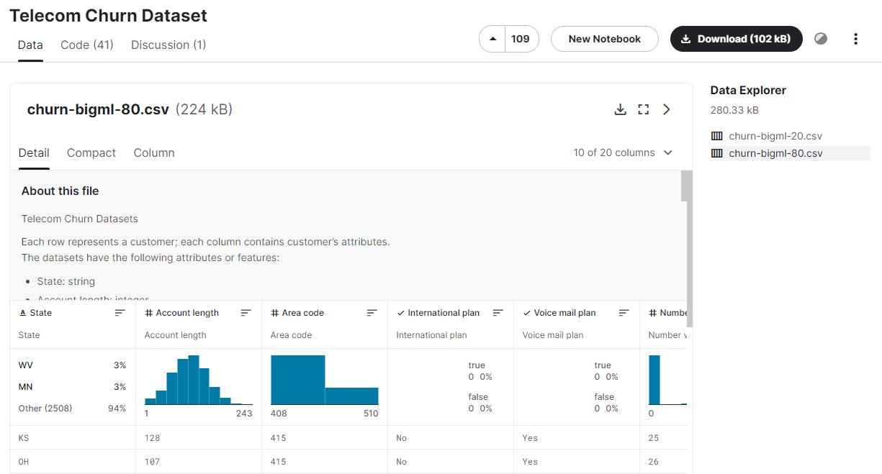
Data Details
The data come from the Telecom Churn Dataset on kaggle
The dataset came pre-split in Training and Test Sets
Very little cleaning needed

Slide 8
Model Selection
Models Tested
Logistic Regression
Decision Tree
Random Forest
K-Nearest Neighbors

Slide 9
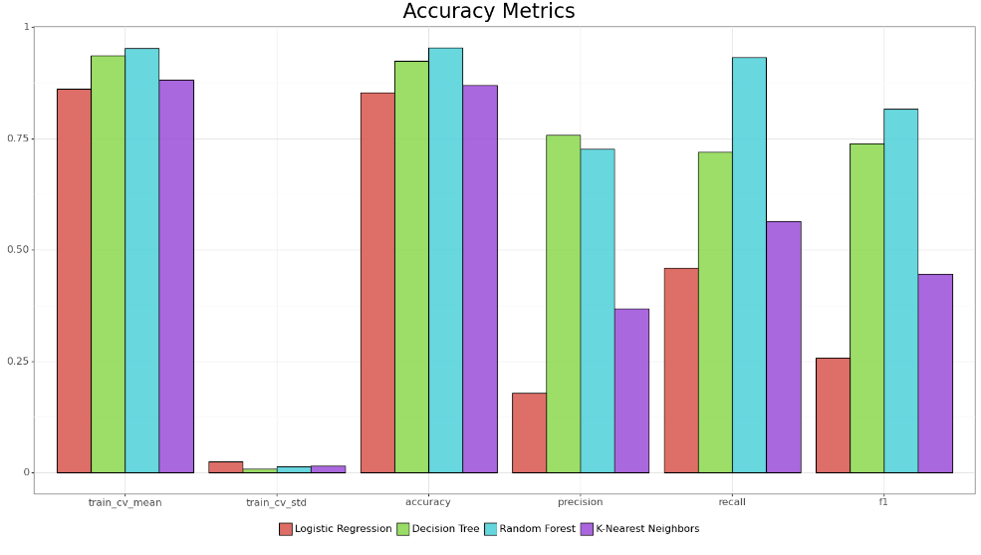
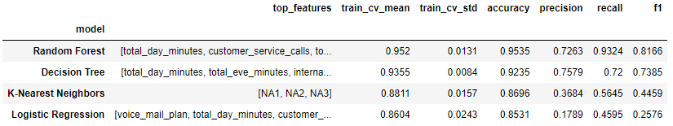
Model Accuracy
Random Forest performed the best in about every accuracy metric
Decision Tree was fairly close
Logistic Regression and K-Nearest Neighbors lagged behind especially in Precision, Recall, and F1-Score

Slide 10
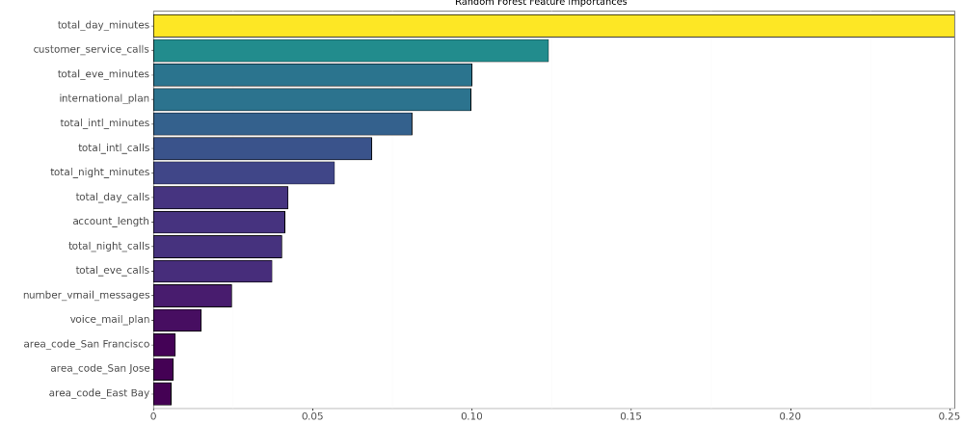
Top Predictors
Tier 1:
total_day_mintues
Tier 2:
customer_service_calls
Total_eve_minutes
international_plan
Tier 3:
Total_intl_minutes
Total_intl_calls
total_night_minutes

Slide 11
Shortcomings
Industry knowledge
Company knowledge
Qualitative Data

Slide 12
The End!

